Slide 1
ECED3901 Design Methods II
Lecture #1: Introduction
Colin O’Flynn

Slide 2
Objective of this Course

Slide 3
Who Am I?

Slide 4
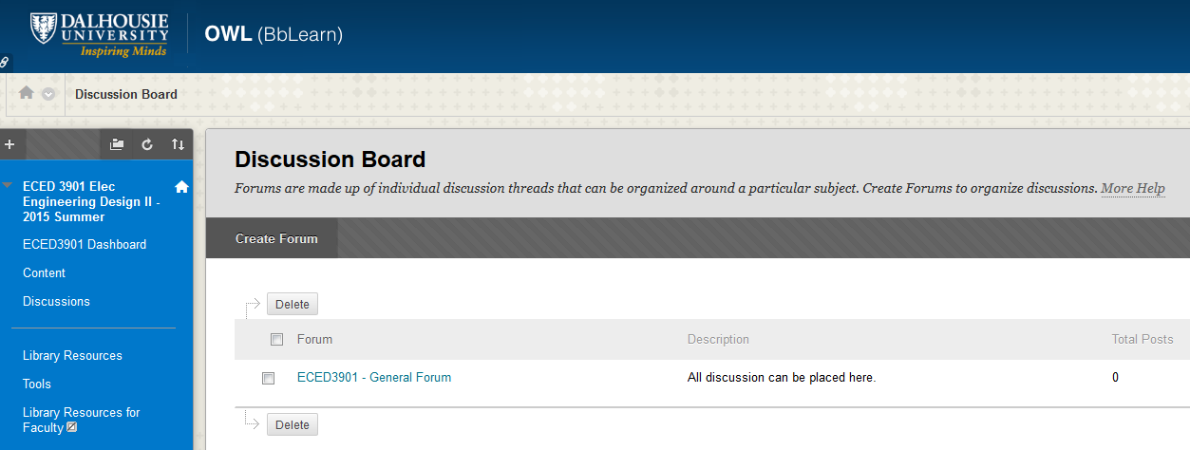
Getting Help
https://dalhousie.blackboard.com/

Slide 5
Getting Help
For private matters only, contact me via email: coflynn@dal.ca
Use online forum for questions, as classmates can also help (who will be faster in responding than myself), or if it’s a question on assignment/deadlines other students can see my answer.
Office Hours: Thursdays, Room C105, 10:30am-11:30am

Slide 6
Example – 2013 Contest Video

Slide 7
Contest Theme This Year…
Italian Plumbers!
*Any resemblance to fictional or real-life characters is purely coincidental.

Slide 8
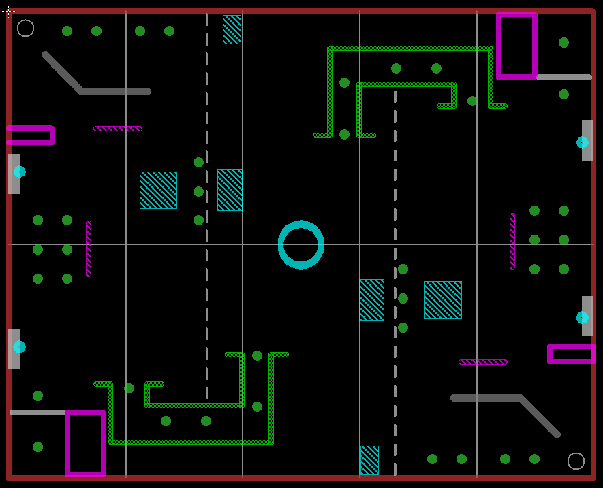

Slide 9
Scoring System
Coin = 1 point (point assigned to whichever side it lies on, NOT who collected it)
Knock over wall = -2 point
Get advanced coin = 6 points
Get flag = 2 points + round[(120 – Tleft)*0.05]
Maximum points = 19+6+8

Slide 10
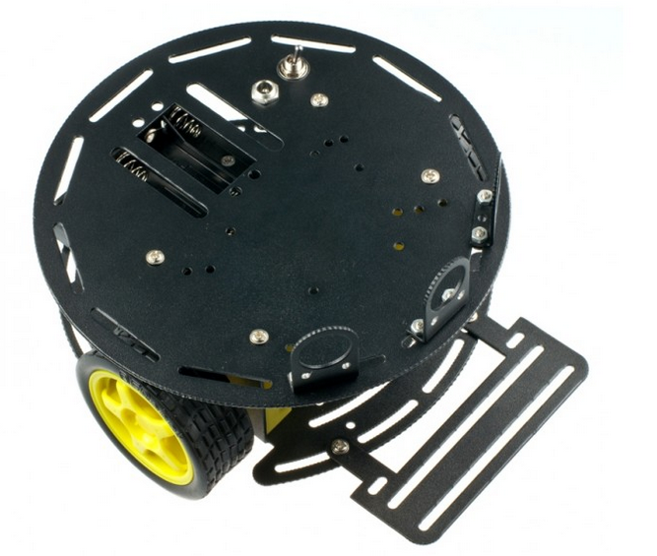
Your Tools
Source: DFRobot.com

Slide 11
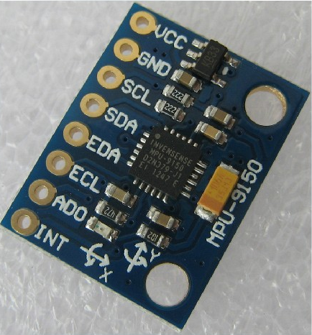
Your Tools
Source: aliexpress.com

Slide 12
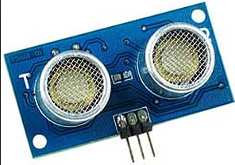
Your Tools
Source: www.futurlec.com

Slide 13
Your References
Labs will teach you about various aspects of design
See previous contests for inspiration, talk to participants
References about the microcontroller board, see ECED3204 Labs:
https://github.com/colinoflynn/eced3204

Slide 14
Questions?

